Slide 1

Predictive Maintenance System for Server Failure Prediction Using Machine Learning and Deep Learning
Birla Institute of Technology and Science, Pilani
Team Members:
[Member 1 Name] - [Roll Number]
[Member 3 Name] - [Roll Number]
[Member 2 Name] - [Roll Number]
[Member 4 Name] - [Roll Number]

Slide 2
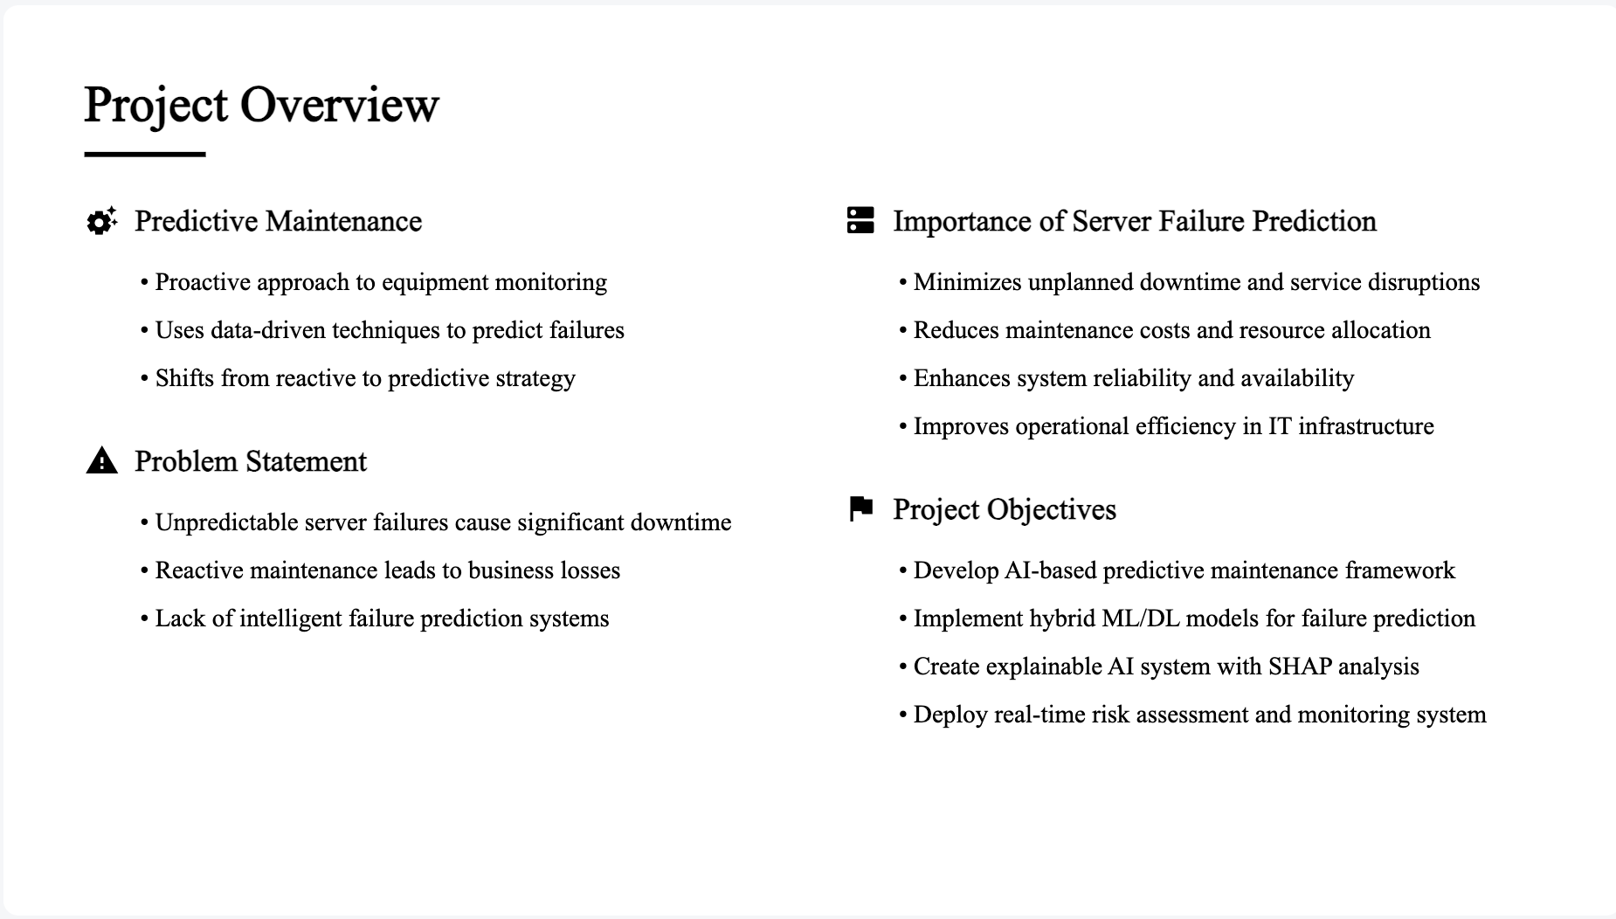

Slide 3
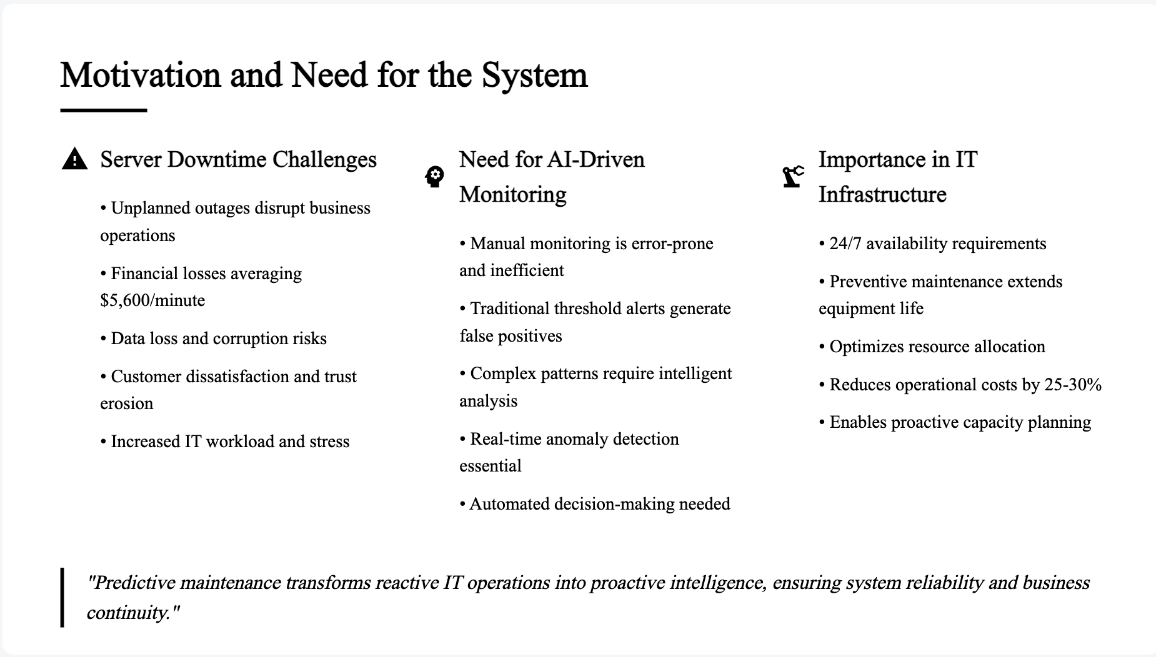

Slide 4
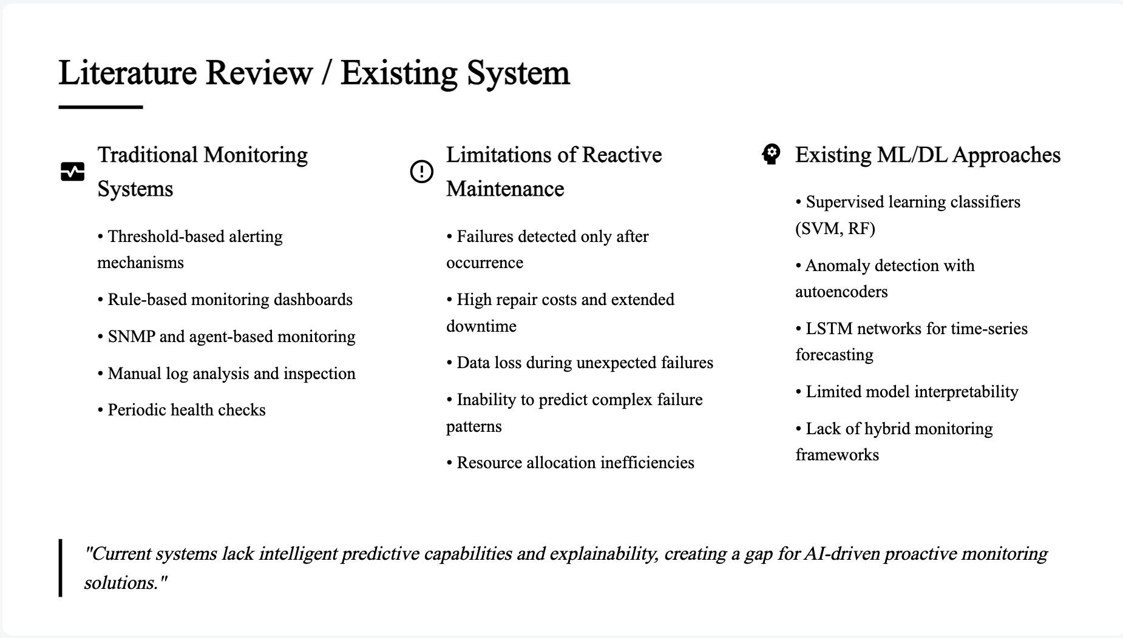

Slide 5
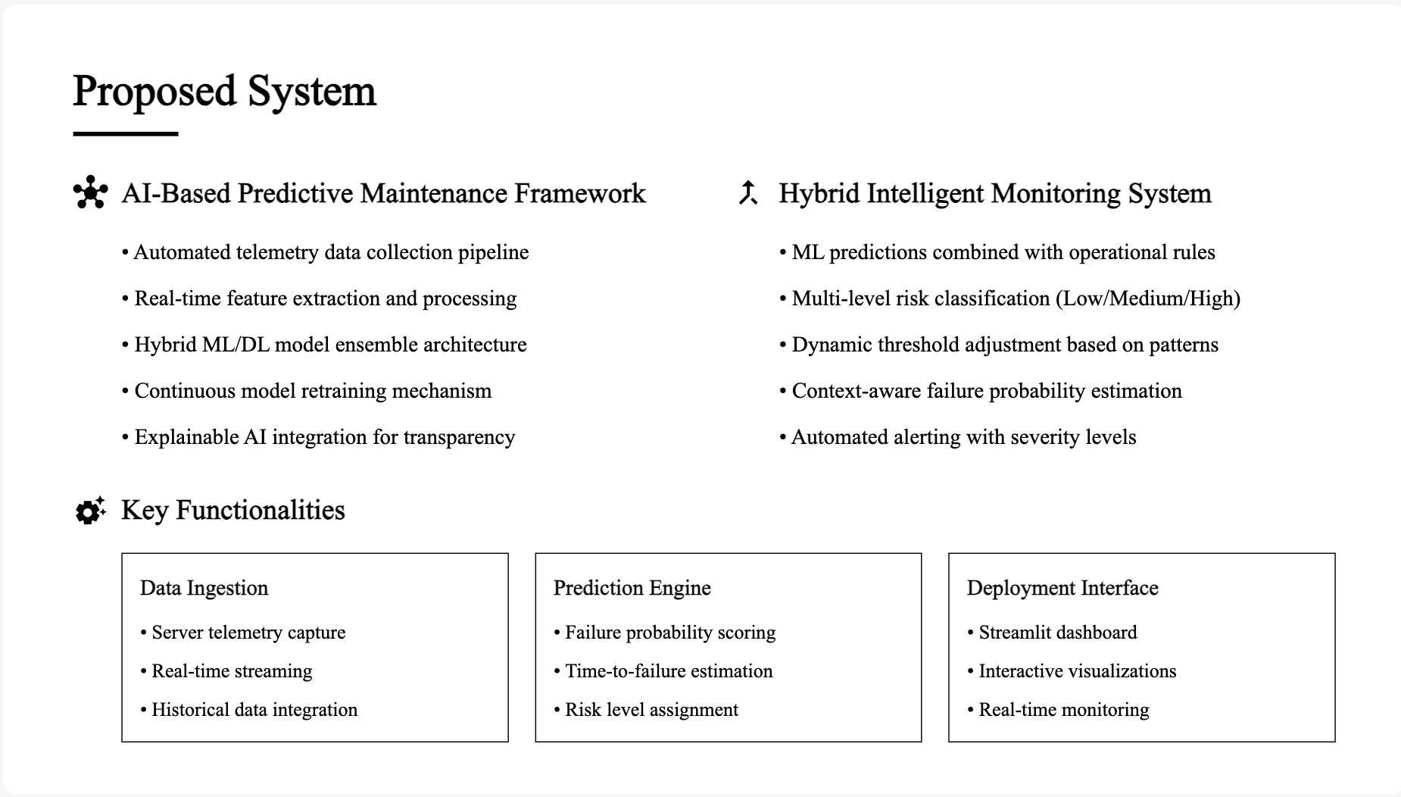

Slide 6
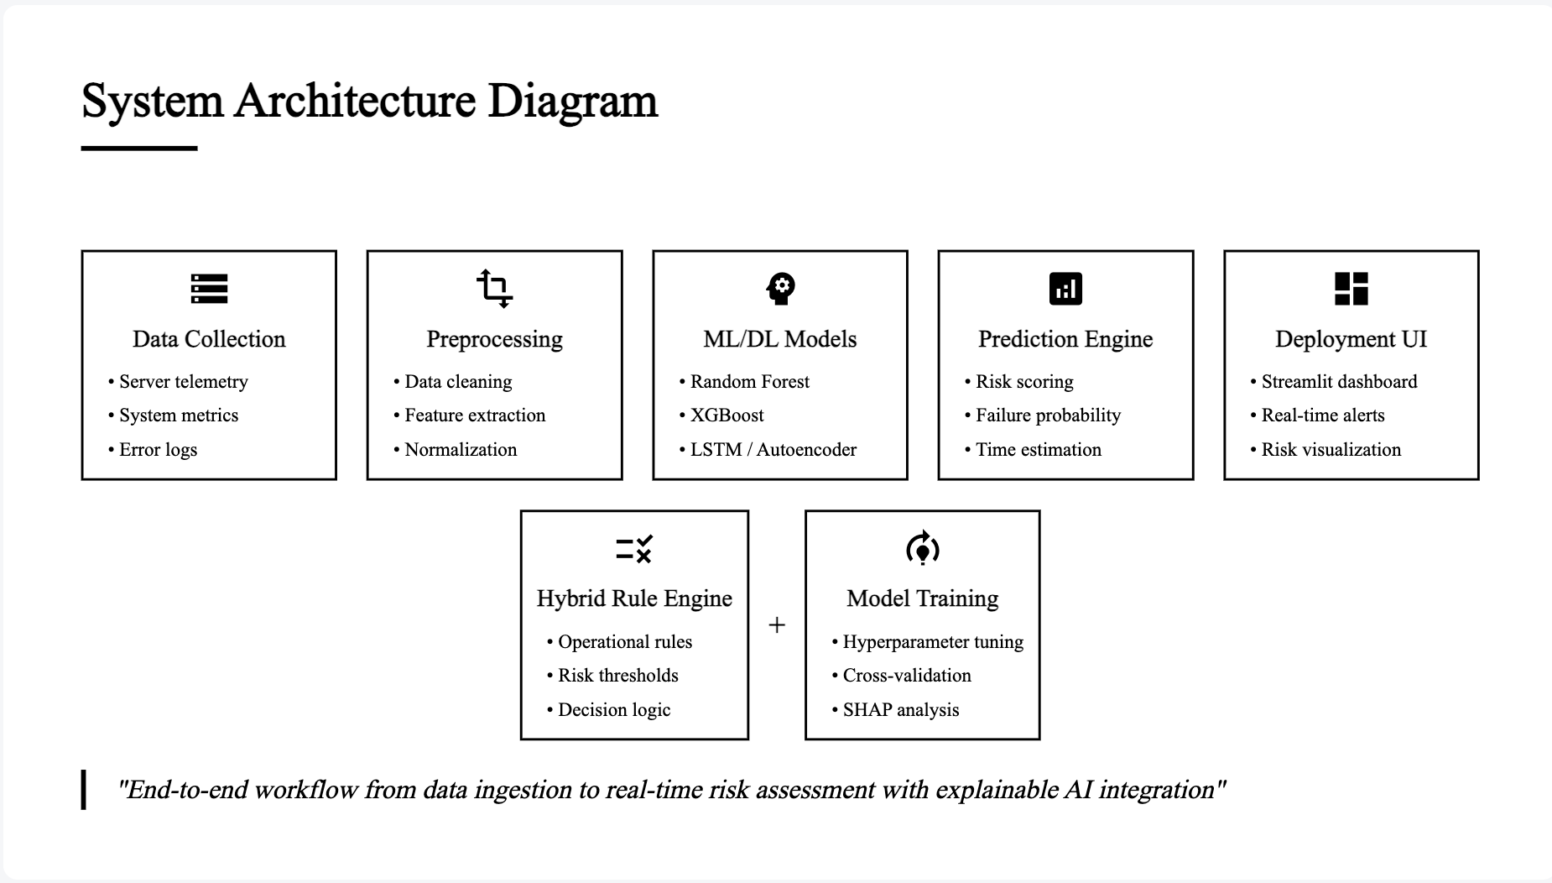

Slide 7
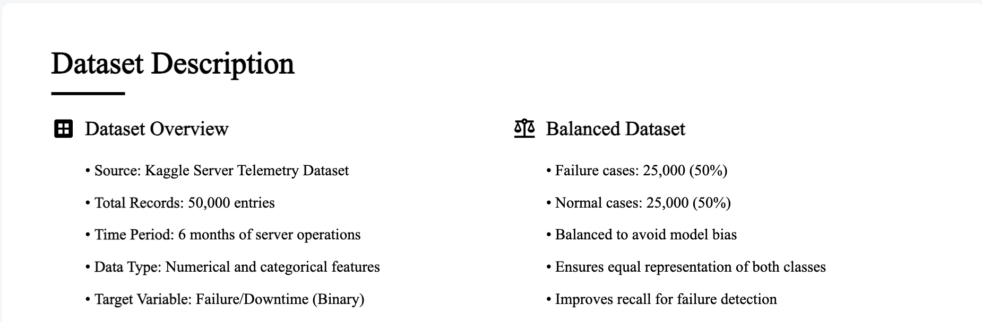

Slide 8
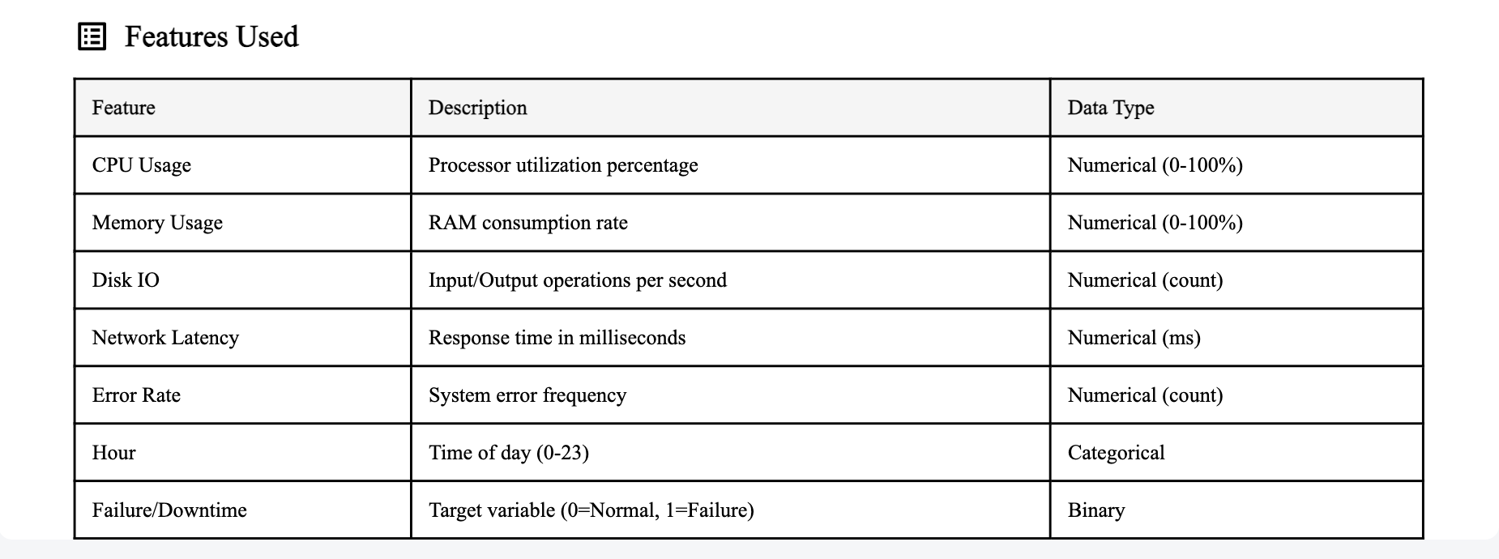

Slide 9
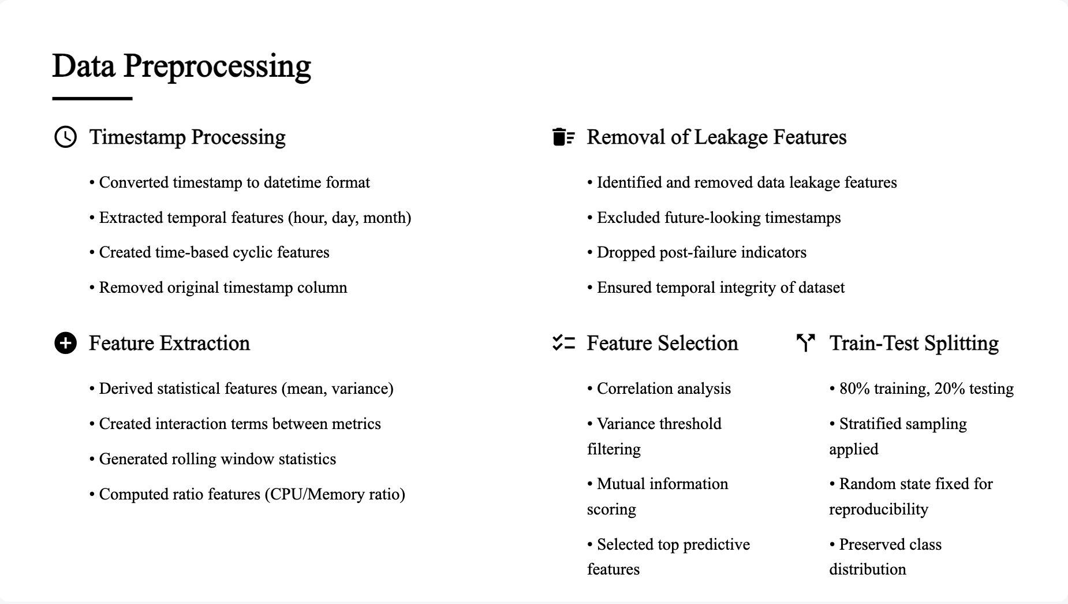

Slide 10
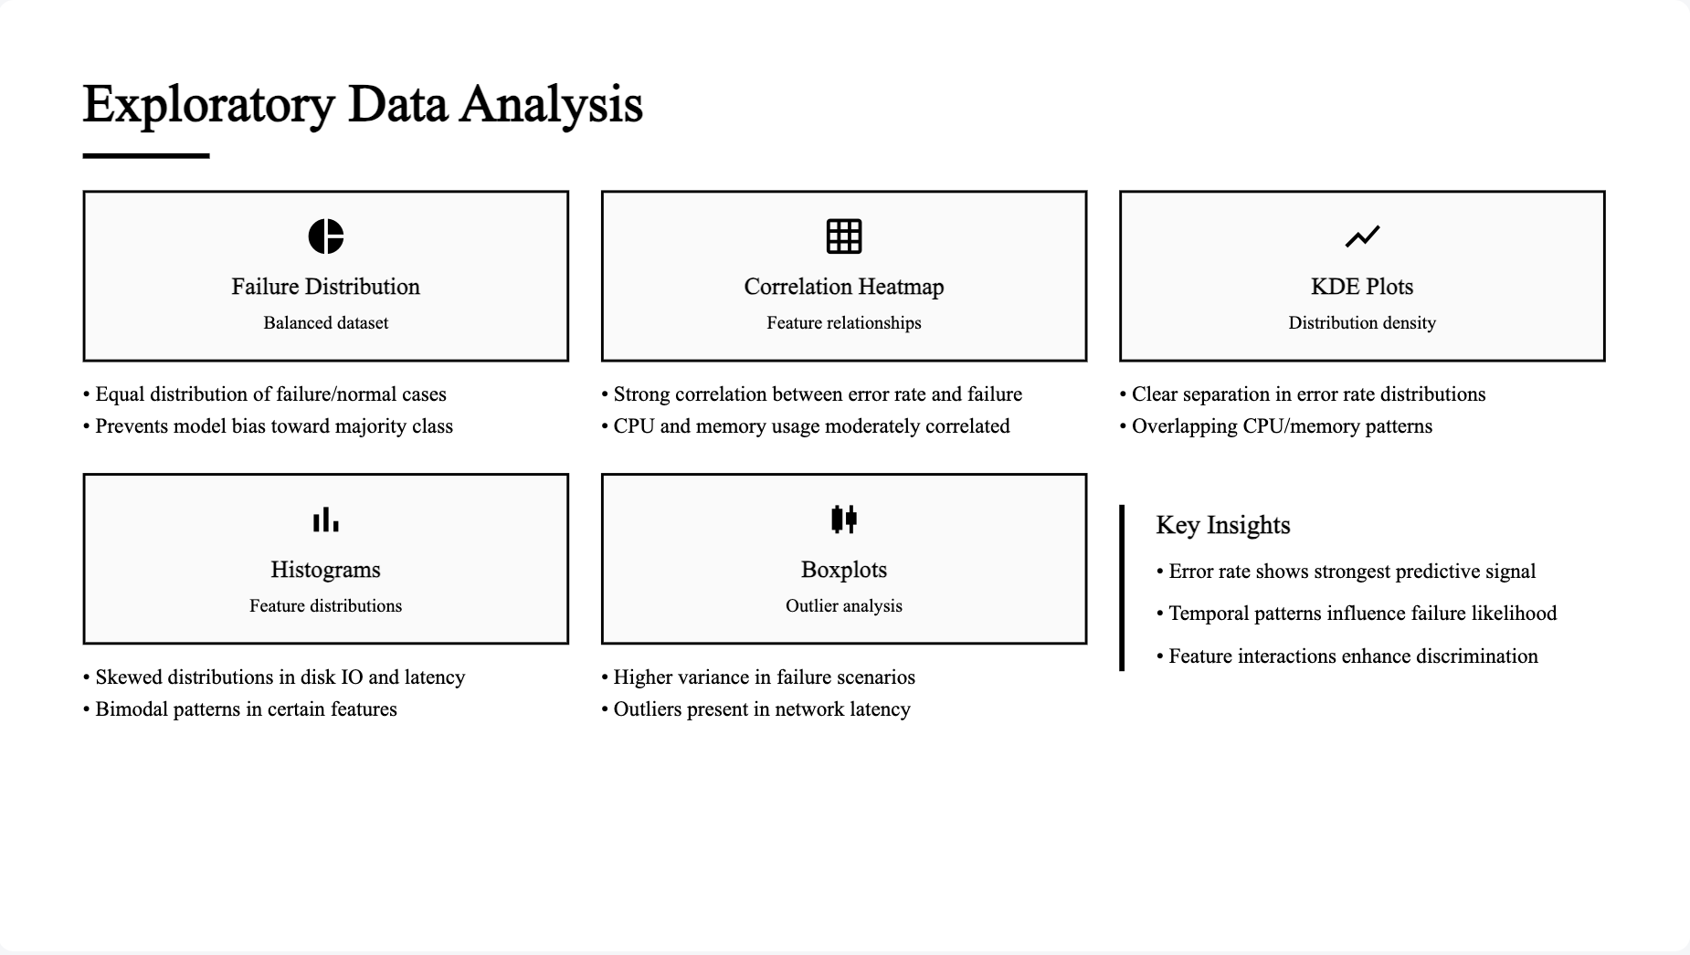

Slide 11
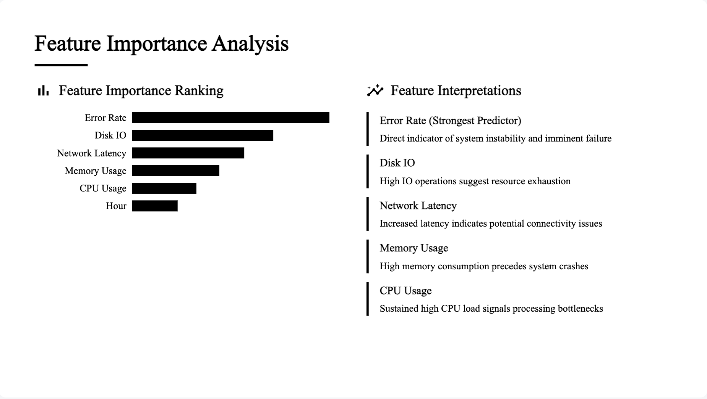

Slide 12
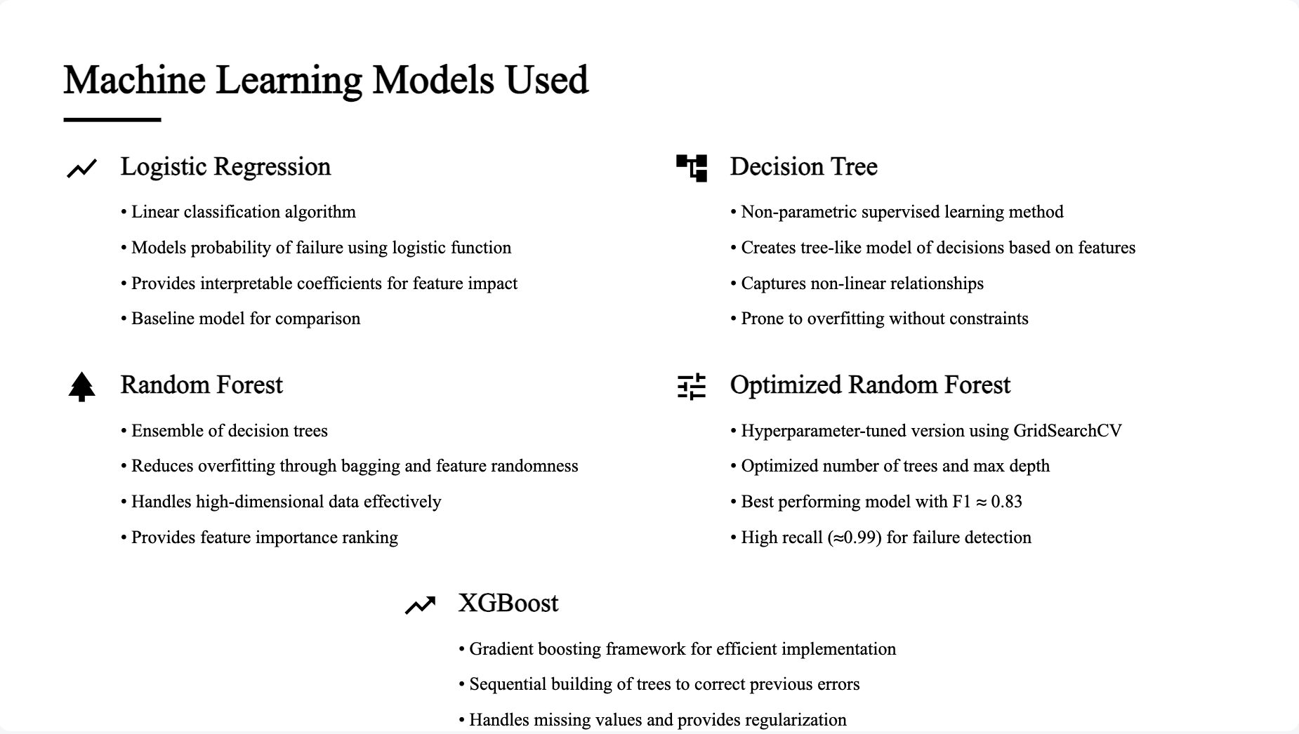

Slide 13
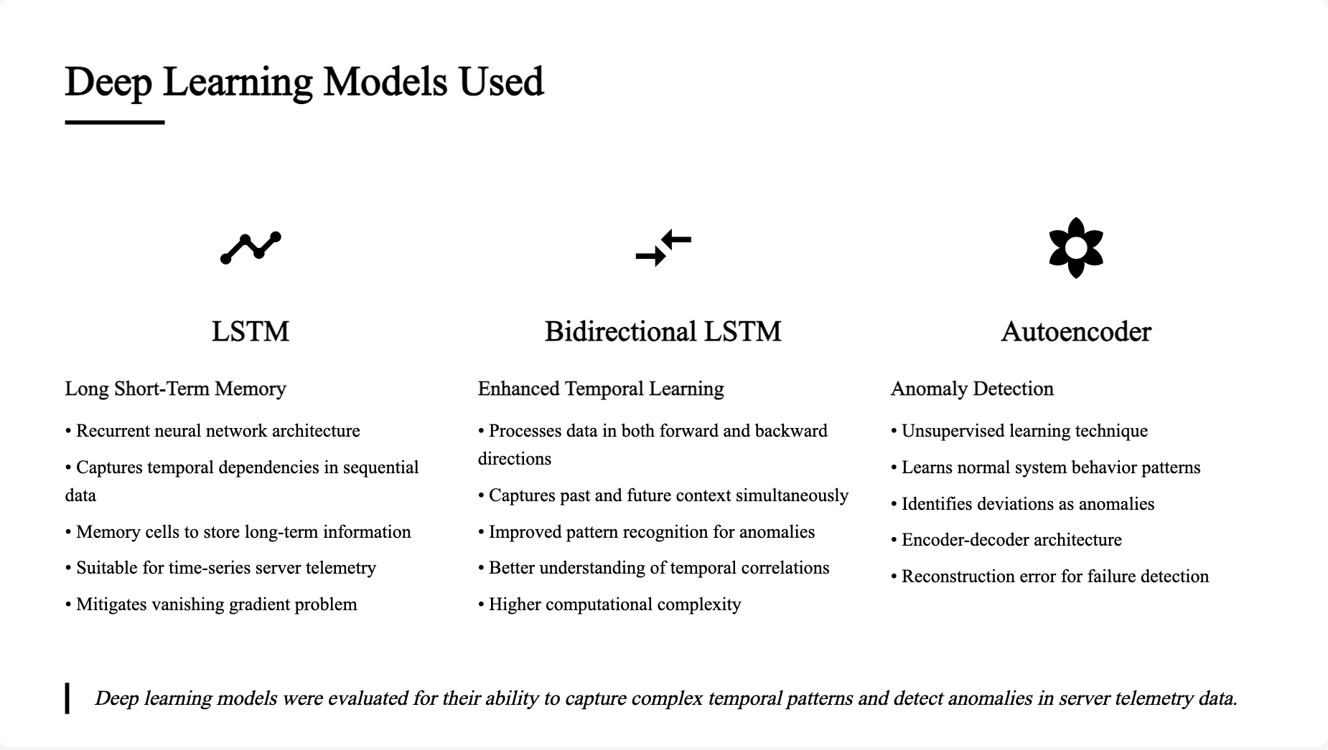

Slide 14
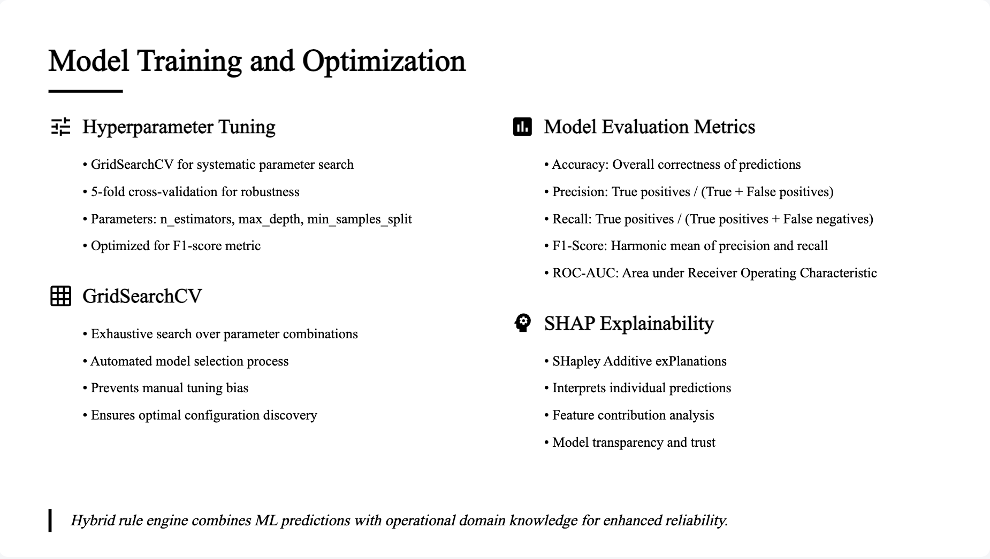

Slide 15
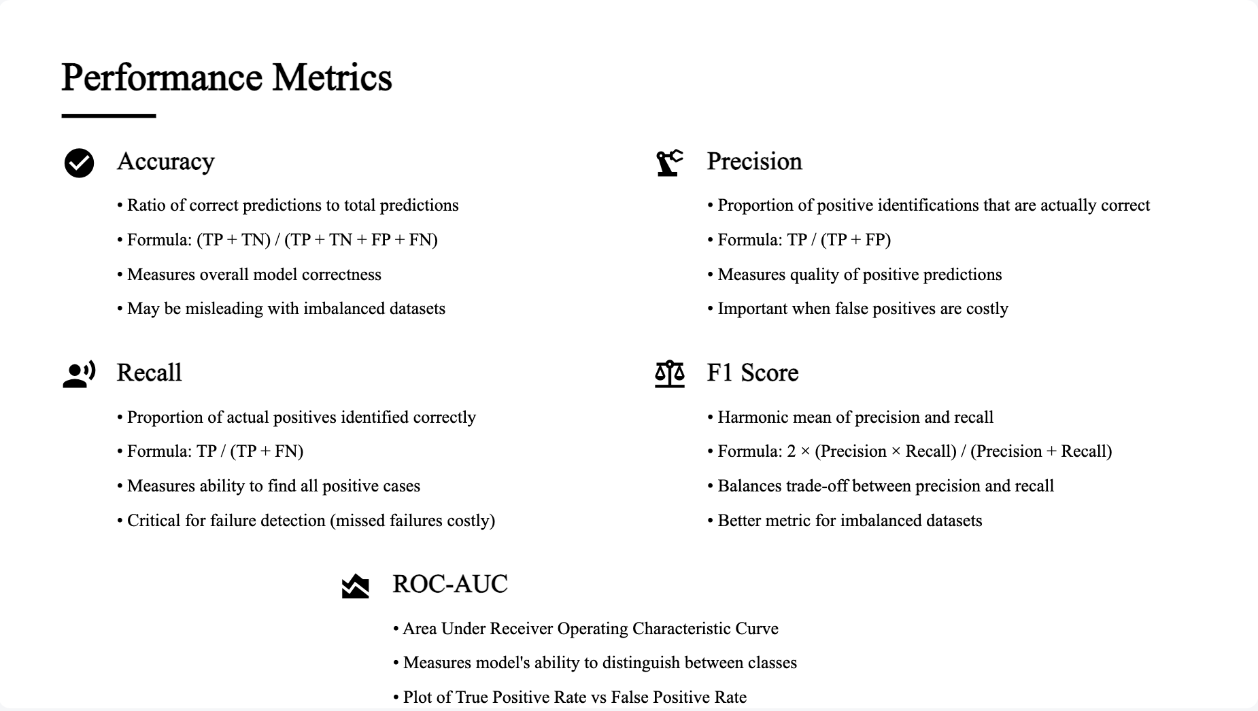

Slide 16
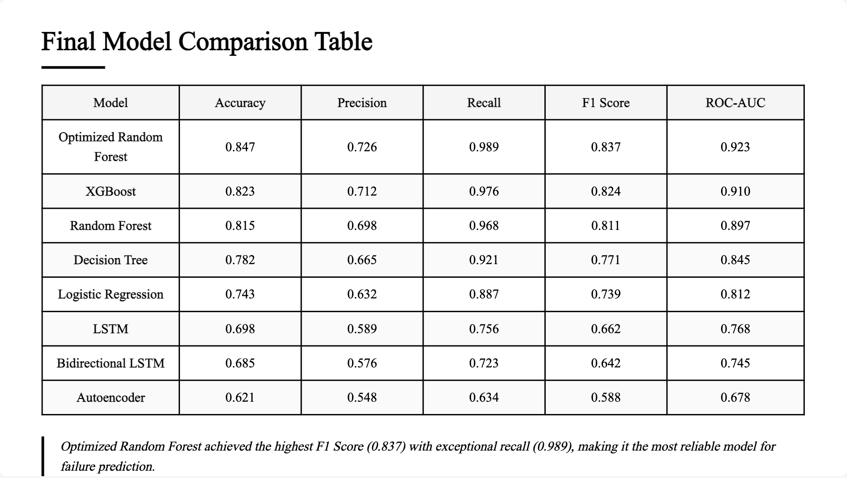

Slide 17
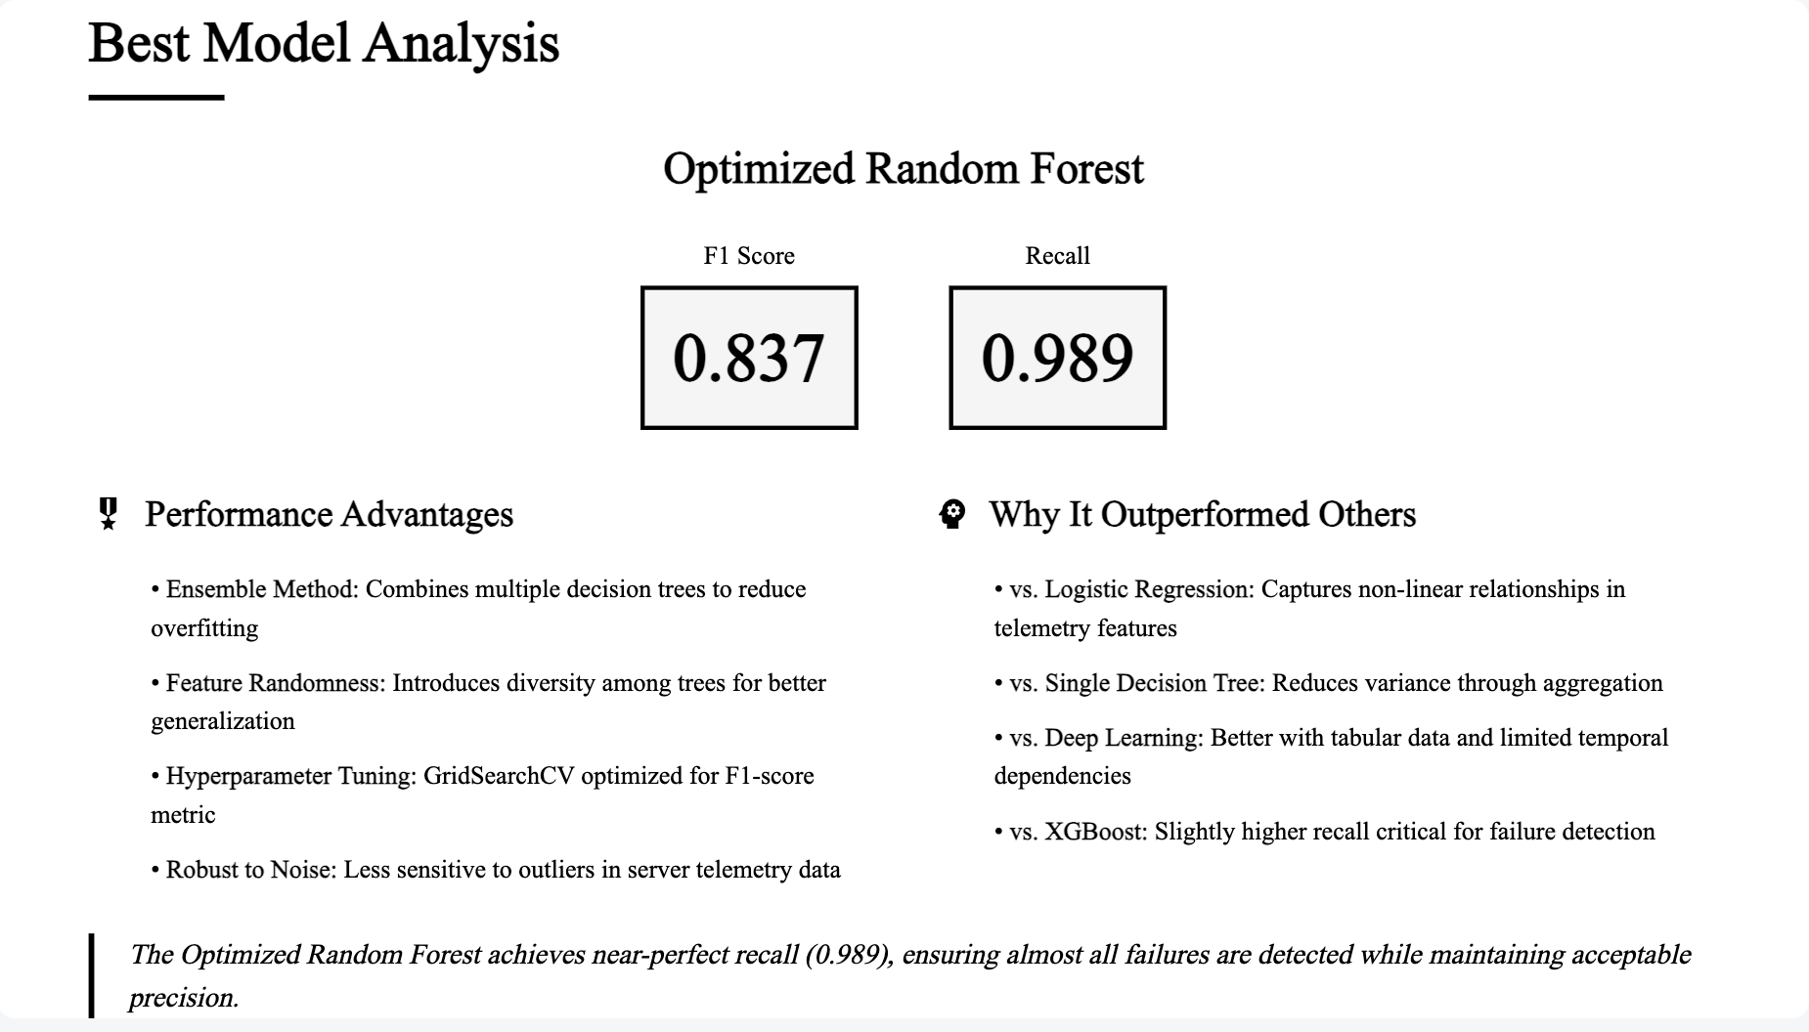

Slide 18
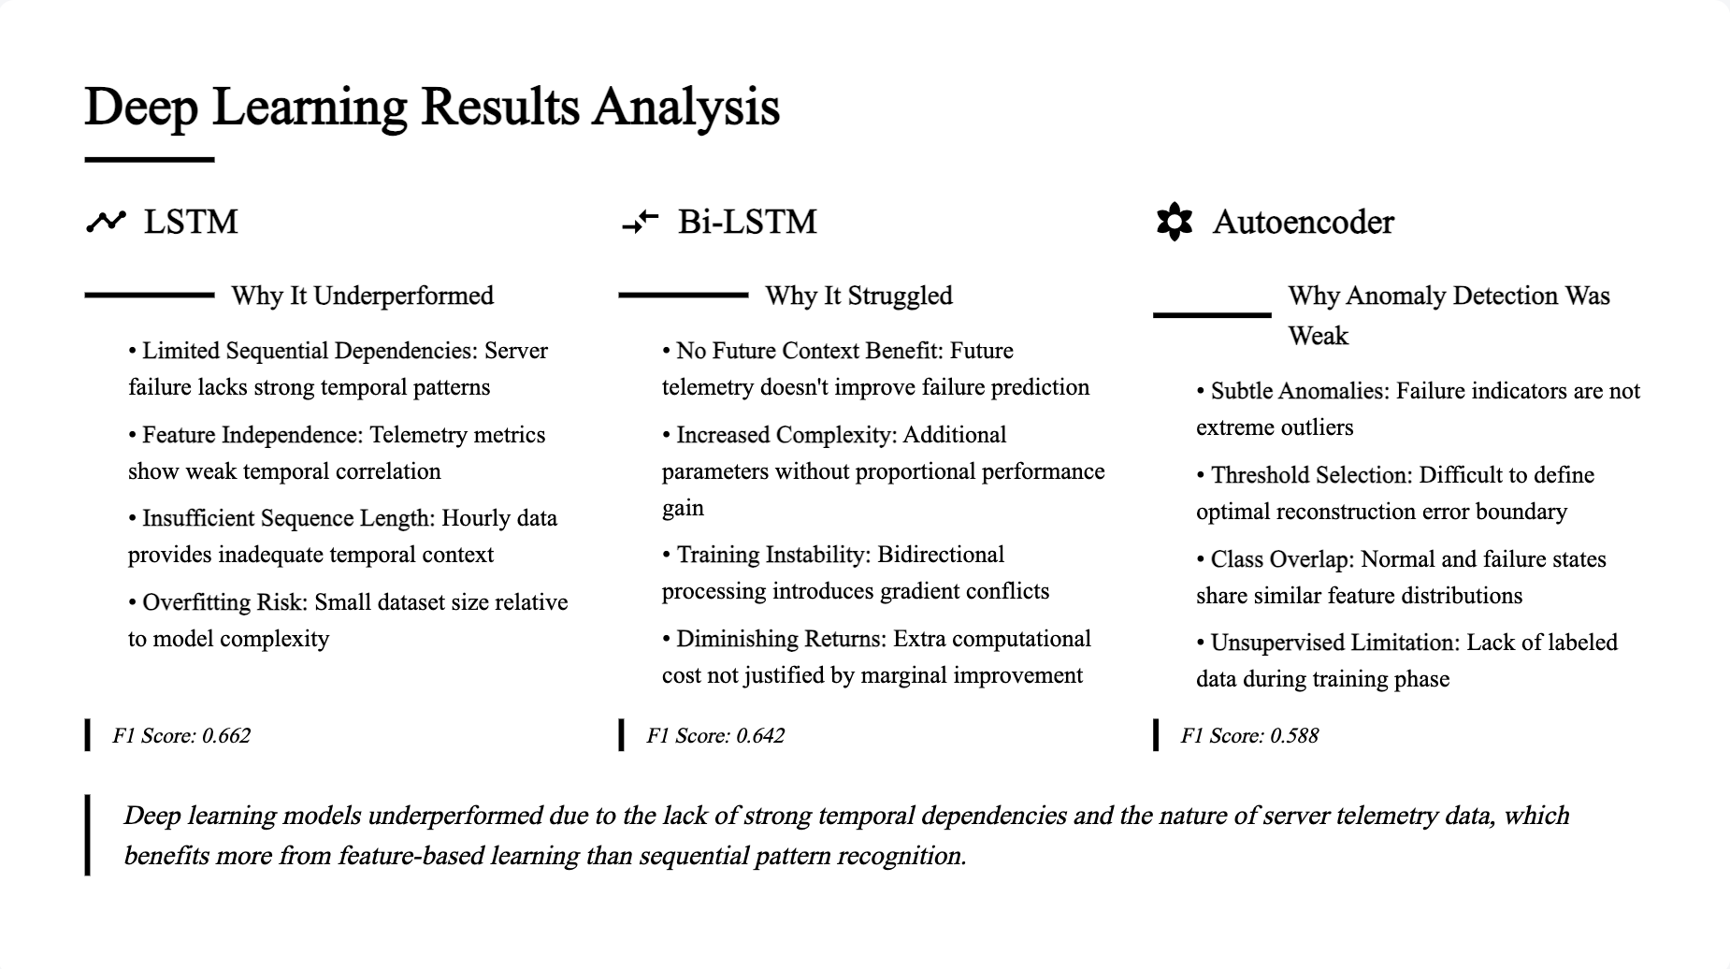

Slide 19
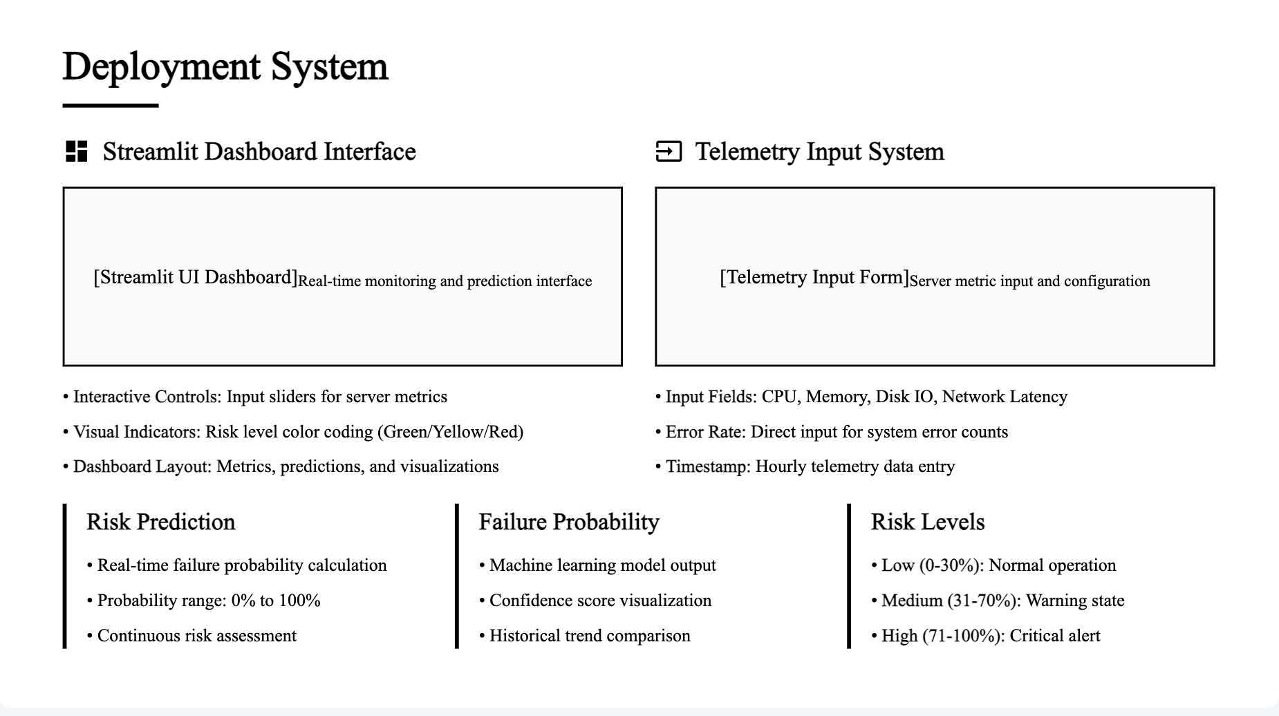

Slide 20
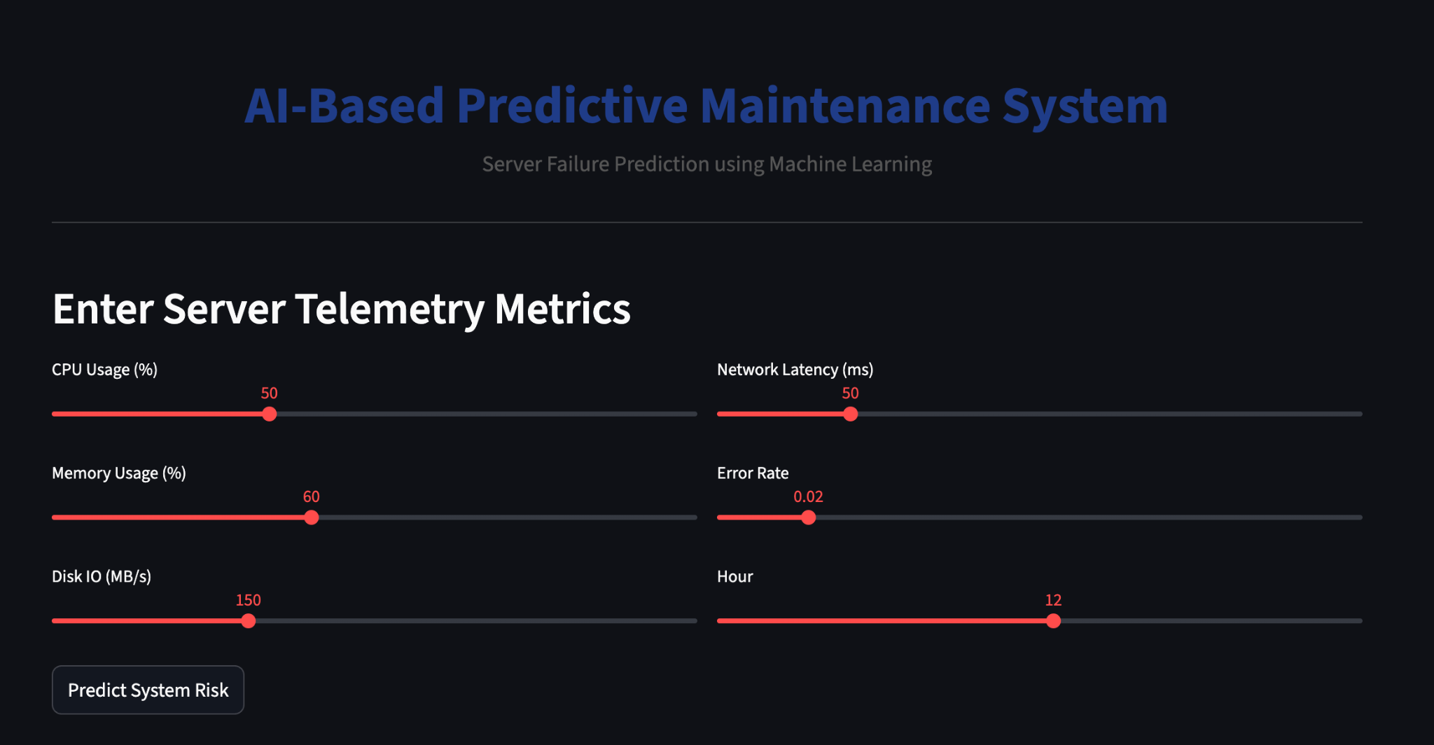

Slide 21
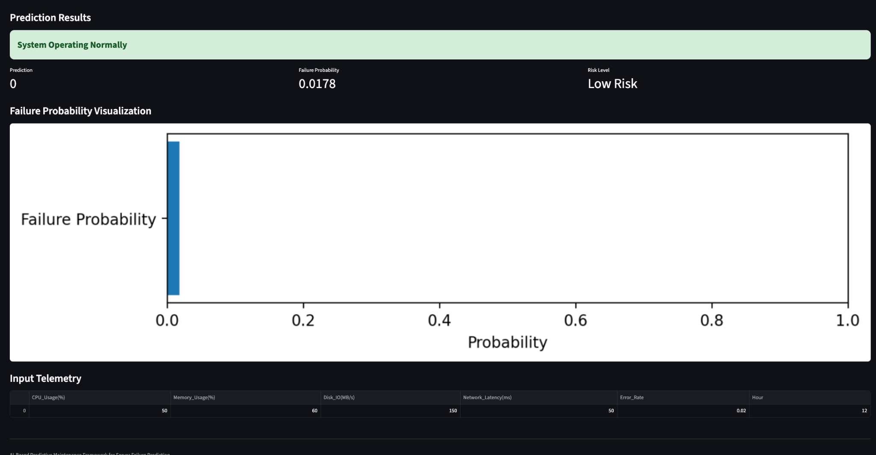

Slide 22
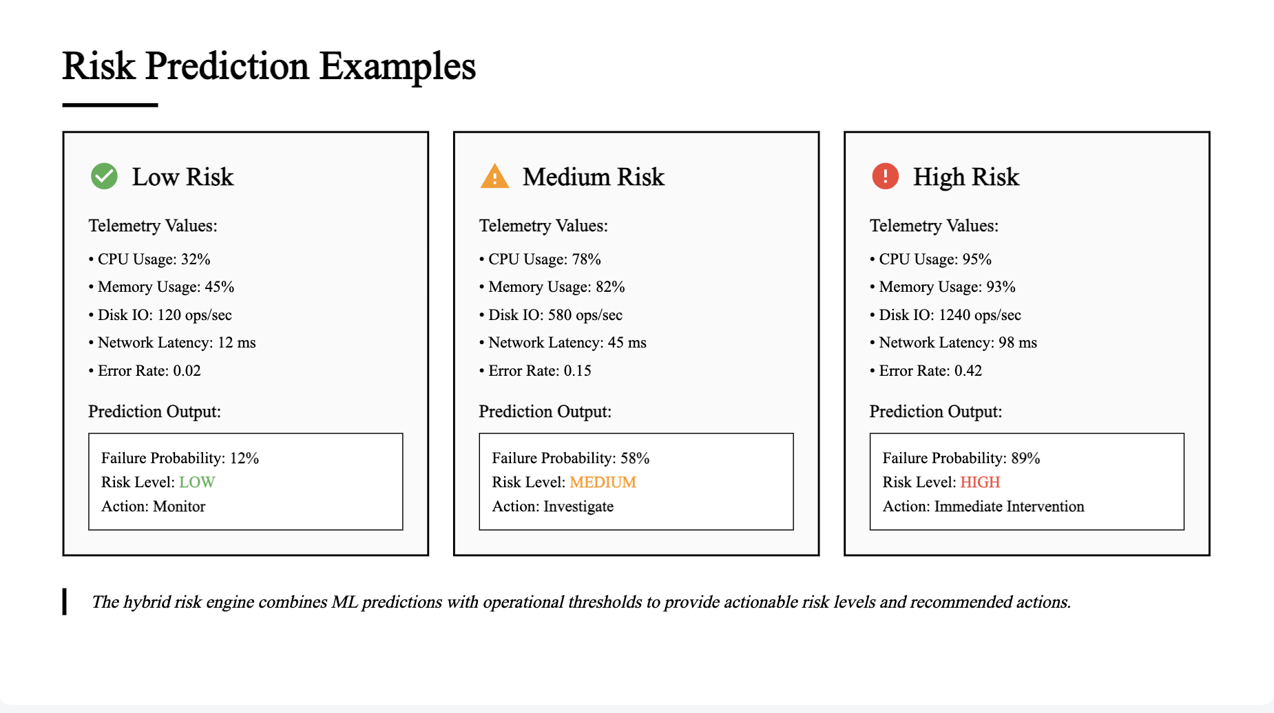

Slide 23
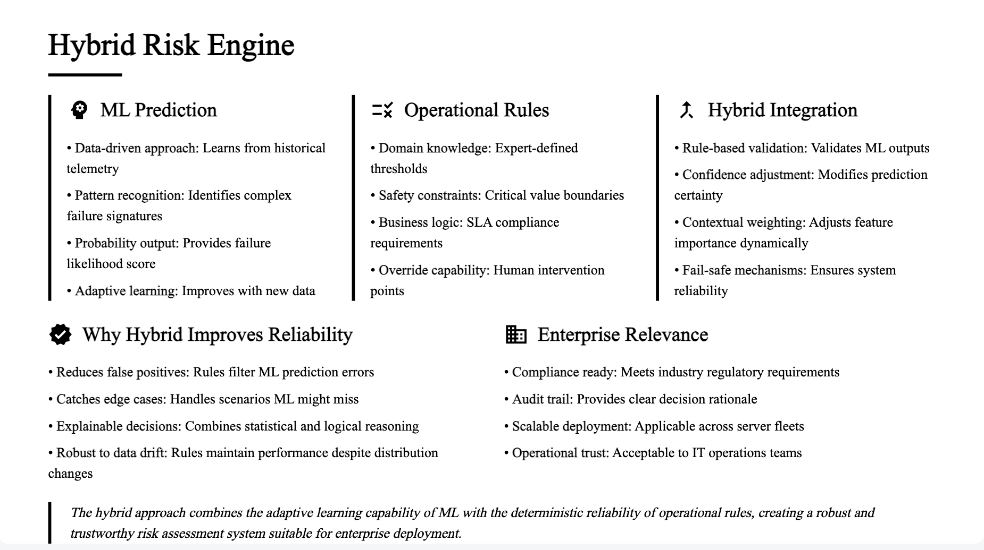

Slide 24
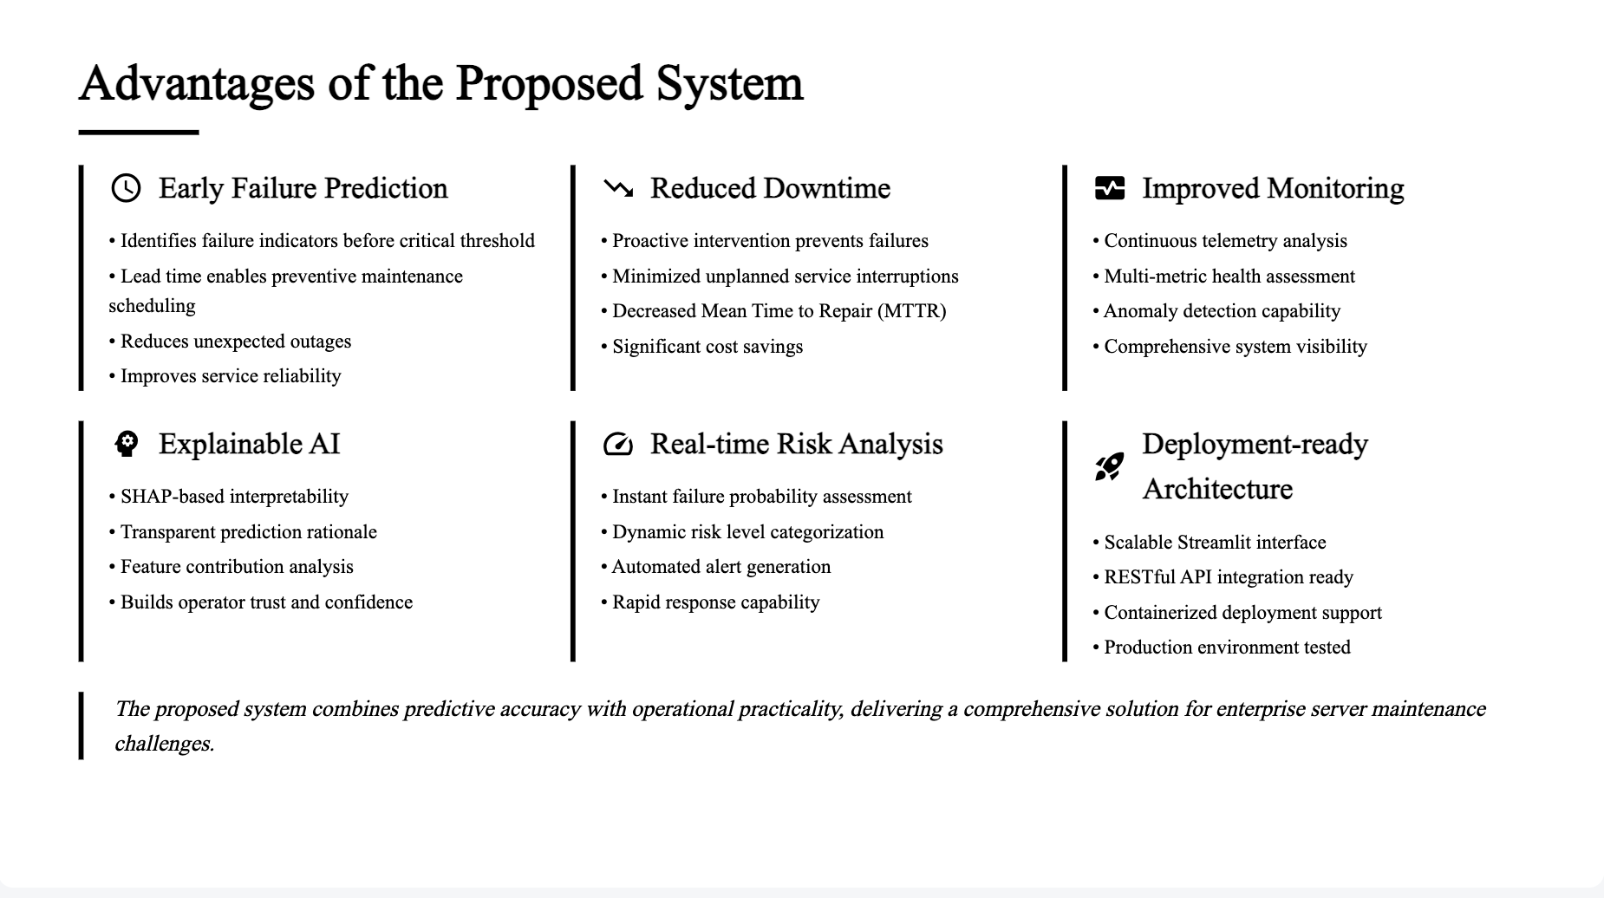

Slide 25
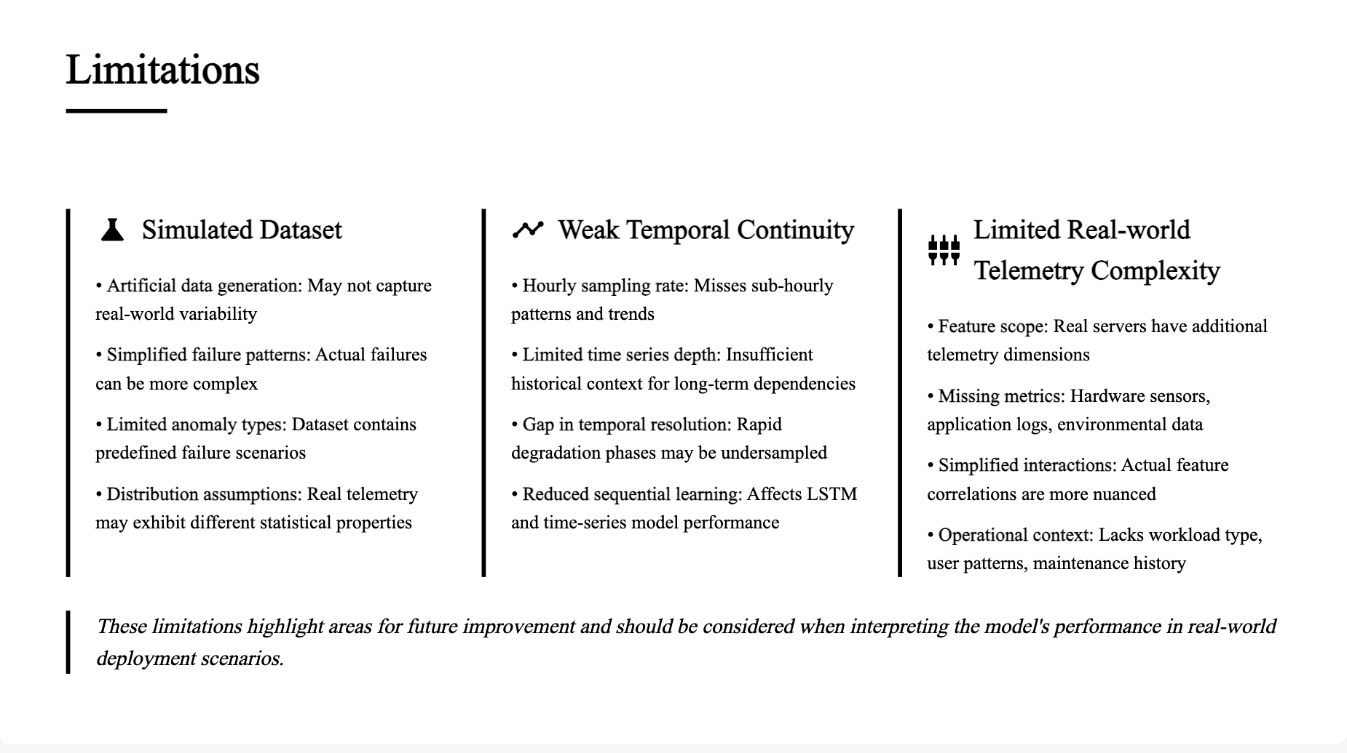

Slide 26
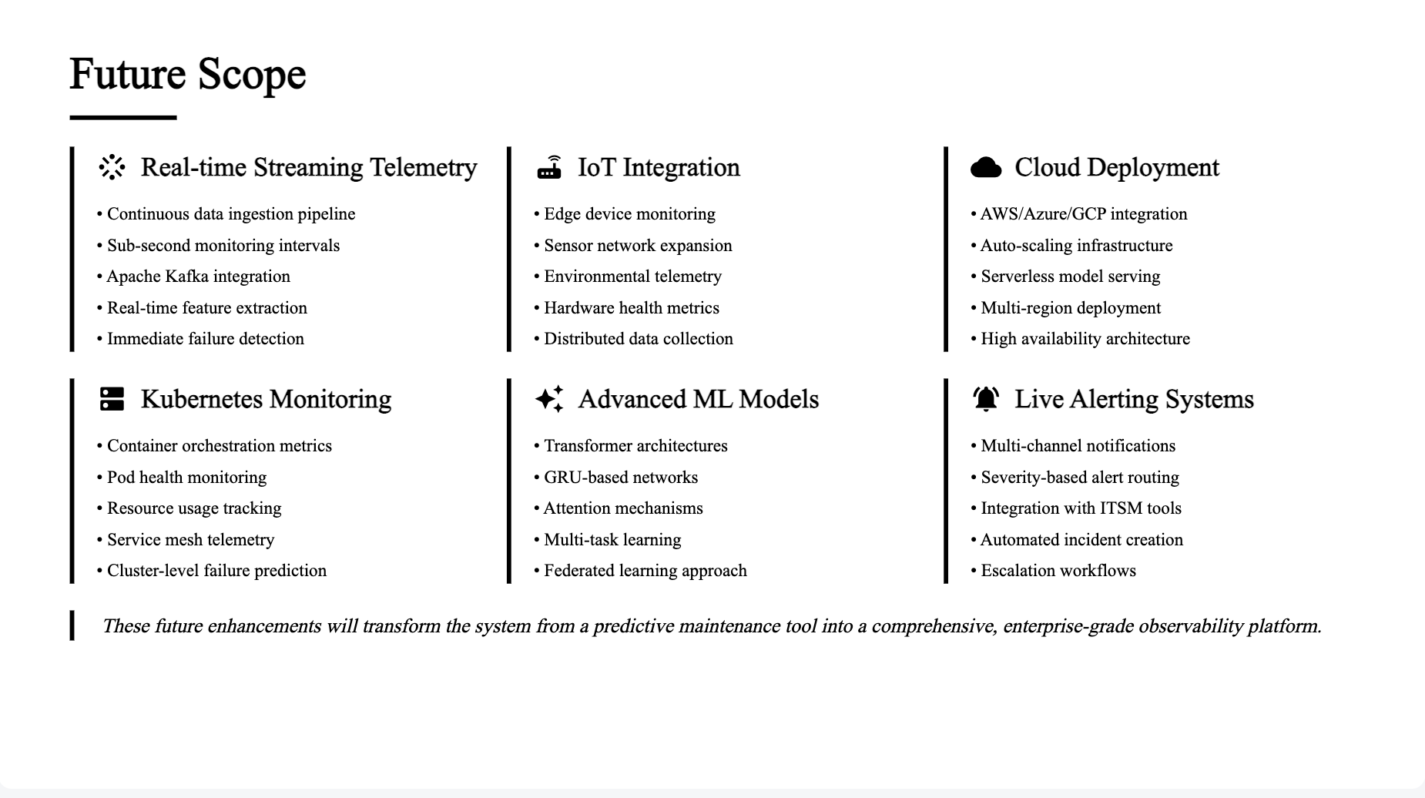

Slide 27
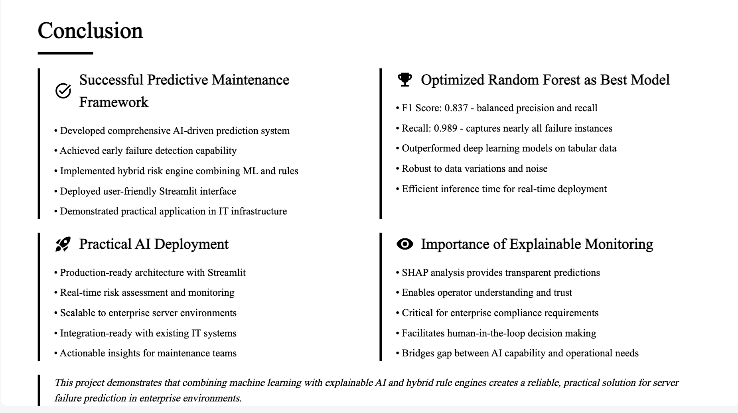

Slide 28
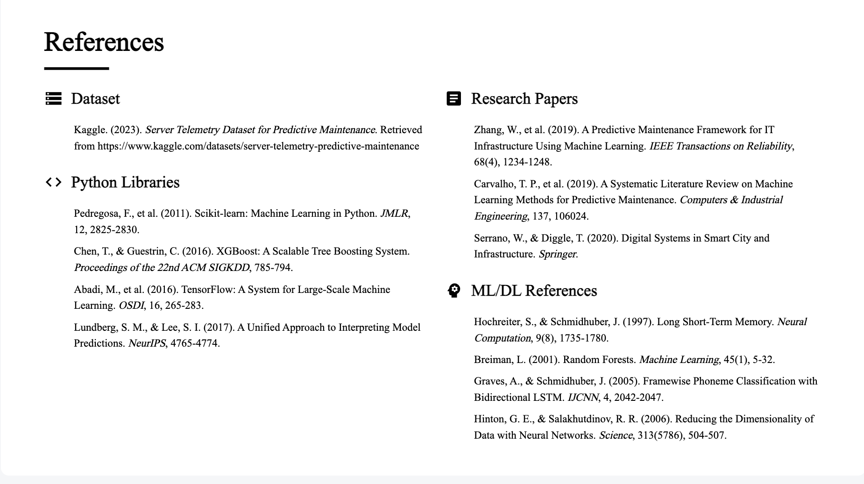

Slide 29
Thank You
Questions?
Project Team
[Team Member 1]
[Team Member 3]
Roll No: [XXXX]
Roll No: [XXXX]
[Team Member 2]
[Team Member 4]
Roll No: [XXXX]
Roll No: [XXXX]
Department of Computer Science and Engineering
[College Name] • Academic Year 2025-2026

